Slide 1
Design Patterns: Design by Abstraction
CS 3331
Chapter 7

Slide 2
Outline
Design pattern
Reusable component
Template method
Strategy pattern
Factory pattern

Slide 3
Motivation
Modeling solar system
1..*
0..*
Sun
Planet
Moon
Q: How to make sure that there exists only one Sun object in the system?

Slide 4
In Java …
public class Sun {
private static Sun theInstance = new Sun();
private Sun() { /* … */ }
public static Sun getInstance() {
return theInstance;
}
// the rest of code …
}
Q1: Can a client create a Sun? “protected” constructor?
Q2: Can a client access the unique Sun? “public” final field?

Slide 5
In General …
T
- theInstance: T { static }
T()
+ getInstance(): T { static }
return theInstance;

Slide 6
Singleton Design Pattern
Intent
To ensure that a class has only one instance and provides a global access point to it
Applicability
Use the Singleton pattern when there must be exactly one instance of a class and it must be accessible to clients from a well-known access point
Benefits
Controlled access to the sole instance
Permits a variable number of instances

Slide 7
What Are Design Patterns?
Design patterns are:
Schematic descriptions of design solutions to recurring problems in software design, and
Reusable (i.e., generic), but don’t have to be implemented in the same way
That is, describe:
Design problems that occur repeatedly, and
Core solutions to those problems

Slide 8
Why Design Patterns?
To capture and document software design knowledge
=> helps designers acquire design expertise
To support reuse in design and boost confidence in software systems
To provide a common vocabulary for software designers to communicate their designs

Slide 9
Gang of Four (GoF) Patterns*
Creational Structural Behavioral
Abstract Factory Adapter Chain of Responsibility
Builder Bridge Command
Factory Method Composite Interpreter
Prototype Decorator Iterator
Singleton Façade Mediator
Flyweight Memento
Proxy Observer
State
Strategy
Template Method
Visitor
*E. Gamma, R. Helm, R. Johnson, and J. Vlissides. Design Patterns, Elements of Reusable
Object-Oriented Software, Addison-Wesley, 1995.

Slide 10
Generic (Reusable) Components
Generic components
Program components (e.g., classes and packages) that can be extended, adapted, and reused in many different contexts without having to modify the source code
Also known as reusable components
Open-Closed Principle (OCP)
Techniques for designing generic components
Refactoring
Generalizing

Slide 11
Refactoring
Definition
Refactoring means restructuring a program to improve its structure (e.g., to eliminate duplicate code segments) without changing its functionality
Approach
Identify code segment that implements the same logic (e.g., duplicate code)
=> Commonality and variability analysis
Capture the logic in a generic component
Restructure by replacing every occurrence of the code segment with a reference to the generic component

Slide 12
Refactoring Duplication
Why?
Hazardous for maintenance
Changes must be repeated everywhere
Some may be overlooked or forgotten
Thus, code segments can easily drift apart
Guidelines
DRY (Don’t repeat yourself)
Rule of Three
Approach
Refactoring by inheritance (use subclassing)
Refactoring by delegation (use composition)
Notes:
when the same code is used three times, it should be extracted into a new procedure

Slide 13
Refactoring by Inheritance
Sample code: any duplicate?
public class A {
public void m1() {
// …
step1();
step2();
step3();
// …
}
// …
}
public class B {
public void m2() {
// …
step1();
step2();
step3();
// …
}
// …
}

Slide 14
Refactored Code*
abstract class C {
protected void computeAll() {
step1();
step2();
step3();
}
}
public class A extends C {
public void m1() {
// …
computeAll();
// …
}
// …
}
public class B extends C {
public void m2() {
// …
computeAll();
// …
}
// …
}
C
A
B
*Use IDE like Eclipse to automate,
i.e., refactor > extract & move.

Slide 15
Exercise
Identify and remove duplicate code.
public class Point {
public Point(int x, int y) {
this.x = x;
this.y = y;
}
protected int x, y;
// other code;
}
public class ColoredPoint extends Point {
public ColoredPoint(int x, int y, Color c) {
this.x = x;
this.y = y;
this.c = c;
}
protected Color c;
// other code
}

Slide 16
Refactoring by Delegation
class Helper {
public void computeAll() {
step1();
step2();
step3();
}
}
public class A {
private Helper h;
public void m1() {
// …
h.computeAll();
// …
}
}
public class B {
private Helper h;
public void m2() {
// …
h.computeAll();
// …
}
}
A
Helper
B

Slide 17
In-Class (Pair, 2 Mins)
Compare the two techniques of refactoring
Pros and cons?
Which one to use?

Slide 18
Inheritance vs. Delegation
Two different methods of code reuse
Inheritance: White/grey box reuse
Quick and easy to implement (less coding required)
Poor encapsulation and fragile code (base and subclasses)
Fixed at design time (can’t be changed at runtime)
Delegation (or composition): Black box reuse
Access through the defined interfaces (public methods)
Good encapsulation and less implementation dependencies
Dynamic composition possible
More objects, more effort, and careful interface design
General guideline: Favor composition over inheritance

Slide 19
Examples of Reusable Code
AnimationApplet: Reusable class that supports the animation idiom
Applet
timer
AnimationApplet
{abstract}
# delay: int
# dim: Dimension
+ init()
+ start()
+ stop()
javax.Swing.Timer
timer = new Timer(delay, e -> repaint())
timer.start()
timer.stop()

Slide 20
Animation Applet (Cont.)
Refactoring the DigitalClock applet to use the animation applet class.
AnimationApplet
DigitalClock
init()
start()
stop()
paint()
DigitalClock
paint()

Slide 21
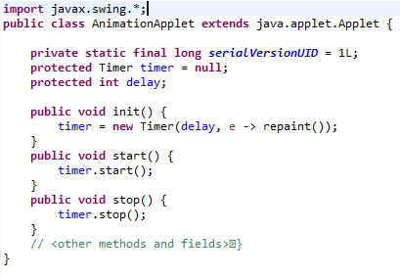

Slide 22
Generic Double-Buffered Animation Applet
Reusable class that supports double-buffered animation
Applet
DBAnimationApplet
{abstract}
+init() {final}
#initAnimation()
+update() {final}
+paint() {final}
#paintFrame() {abstract}
AnimationApplet
{abstract}
image
Image
offScreen
Graphics

Slide 23
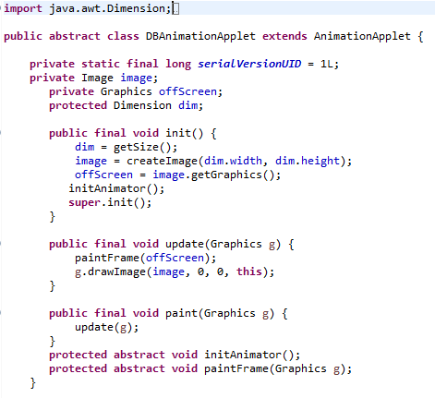

Slide 24
Sample Code
final public void update(Graphics g) {
if (doubleBuffered) {
paintFrame(offscreen);
g.drawImage(image, 0, 0, this);
} else {
paintFrame(g);
}
}
final public void paint(Graphics g) {
update(g);
}
protected abstract void paintFrame(Graphics g);
Questions
Why “final” update and paint, and why “abstract” paintFrame?
How does this cater for both double-buffered and non-DB animation?

Slide 25
DBAnimationApplet (Cont.)
Refactor the bouncing ball applet to use the DBAnimationApplet class
DBAnimationApplet
init()
initAnimator()
update()
paint()
paintFrame()
Note that:
init() calls initAnimation() which is
overridden in the subclass, and
Both update() and paint() call
paintFrame() which is overridden
in the subclass.
BouncingBall
initAnimator()
paintFrame()

Slide 26
Template Methods Design Pattern
Intent
To define a skeleton algorithm by deferring some steps to subclasses
To allow the subclasses to redefine certain steps
AbstractClass
templateMethod()
hookMethod1()
hookMethod2()
…
hookMethod1()
…
hookMethod2()
…
ConcreteClass
hookMethod1()
hookMethod2()

Slide 27
Template Methods (Cont.)
Terminology
Hook methods: placeholders for the behaviour to be implemented by subclasses
Template methods: methods containing hook methods
Hot spots: changeable behaviours of generic classes represented by hook methods
Frozen spots: fixed behaviours of generic classes represented by template methods

Slide 28
Exercise
Identify hook methods and template methods in the DBAnimationApplet class.

Slide 29
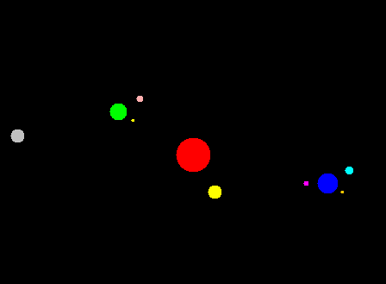
In-Class (Pair): Solar System
Write an animation applet that shows the sun and a planet orbiting around the sun. Use the DBAnimationApplet class. Hint: Use the polar notation to denote a position.
Extend to introduce moons for some planets.
Use Singleton design pattern for the Sun
distance
angle
private int calX() {
int center = dim.width / 2;
return (int) (center + distance * Math.cos(Math.toRadians(angle))); // angle in degrees (0-360)
}

Slide 30
Another Example
Generic function plotter
To plot arbitrary single-variable functions on a two-dimensional space
Applet
Plotter
func()
paint()
plotFunction()
drawCoordinates()
…
func()
…
PlotSine
func()
PlotCosine
func()

Slide 31
Generalization
Definition
Process that takes a solution to a specific problem and restructures it to solve a category of problems similar to the original problem
Example
Board class to support 4x4, 9x9, etc.
Q: Generalize the plotter class to support multiple functions?

Slide 32
Generic Function Plotter Revisited
Plot an arbitrary single-variable function on a two-dimensional space
Applet
Plotter
func()
paint()
plotFunction()
drawCoordinates()
…
func()
…
PlotSine
func()
PlotCosine
func()

Slide 33
Generic Multiple Function Plotter
Applet
Plotter
func()
paint()
plotFunction()
drawCoordinates()
MultiPlotter
init()
initMultiPlotter()
addFunction()
plotFunction()
func()
1..*
Function
apply()
Sine
apply()
PlotSineCosine
initMultiPlotter()
<<create>>
Cosine
apply()
<<create>>

Slide 34
Multiple Function Plotter (Cont.)
Method Description
init() Template method for initialization
which calls initMultiPlotter()
initMultiPlotter() Hook method for subclasses to set up
functions to be plotted
addFunction() Method to add a function to be plotted
plotFunction() Auxiliary function called by paint()
to plot the functions
func() Method inherited from class Plotter
that is no longer useful in this class

Slide 35
Strategy Design Pattern
Intent
To define a family of algorithms, encapsulate each one, and make them interchangeable
strategy
Context
contextMethod()
Strategy
alogorithm()
strategy.algorithm()
ConcreteStrategyA
algorithm()
ConcreteStrategyB
algorithm()

Slide 36
Question
Have we used the Strategy Pattern before?

Slide 37
Exercise (Pair): HW4
Come up with a HW4 design and express it by drawing a UML class diagram.
In this exercise, focus on new model classes (not UI) such as classes for creating an initial board configuration, solving the current board configuration.
Use the Strategy design pattern.

Slide 38
Abstract Coupling (Low Coupling)
Definition
Abstract coupling means a client access a service through an interface or an abstract class without knowing the actual concrete class that provide the service
Example
Strategy pattern
Iterator pattern
…
Question
Why abstract coupling?

Slide 39
Design Guideline
Program to an interface, not to an implementation!

Slide 40
Iterating over Collection
Accessing all elements of collection objects such as sets, bags, lists, etc.
Collection<T> c = new ArrayList<>();
for (Iterator<T> i = c.iterator(); i.hasNext(); ) {
T elem = i.next();
…
}
// since Java 5 if c is of type Iterable<T>
for (T elem: c) {
… elem …
}
// since Java 8 if c is of type Iterable<T>
c.forEach(elem -> … elem …)
<<interface>>
Iterator<T>
+hasNext(T): boolean
+next(): T
…
<<interface>>
Iterable
+iterator(): Iterator<T>
…

Slide 41
Iterator Pattern
Intent
To provide a way to access the elements of a collection sequentially
<<use>>
Iterator
hasNext()
next()
<<use>>
Collection
iterator(): Iterator
Client
ConcreteCollection
iterator(): Iterator
ConcreteIterator
hasNext()
next()
<<create>>
return new ConcreteIterator()

Slide 42
Exercise (Pair, 5 Mins)
<<interface>>
Iterator<T>
+hasNext(T): boolean
+next(): T
…
Code to implement the Iterator interface
public class Library {
private Book[] books;
/** Returns an iterator to access all books of this library. */
public Iterator<Book> books() { return new LibraryIterator(books); }
private static class LibraryIterator implements java.util.Iterator<Book> {
public void remove() { throw new UnsupportedOperationException(); }
// YOUR CODE HERE …
}

Slide 43
Side: Arrays vs. Collections
Code to implement the Iterator interface; use a collection.
public class Library {
private Book[] books;
private List<Book> books;
/** Returns an iterator to access all books of this library. */
public Iterator<Book> books() {
return books.iterator();
}
}

Slide 44
Exercise (Pair, 1 Min)
Improve the Library class code of the previous exercise so that one can write code like the following.
Hint: What interface needs to be implemented?
Library lib = new Library();
…
for (Book b: lib) {
System.out.println(b.toString());
}
// or in Java 8
lib.forEach(b -> System.out.println(b.toString());

Slide 45
Factory Design Pattern
Intent
To decouple object creation from its use and to support different way of creating objects
To define an interface for creating objects but let subclasses decide which class to instantiate and how
Client
AbstractFactory
makeProduct()
Product
create
ConcreteProuct
ConcreteFactory
makeProduct()

Slide 46
Example
Complex numbers
ComplexFactory
makeComplext()
Complex
<<create>>
PolarFactory
makeComplex()
PolarComplex
RectangularFactory
makeComplex()
<<create>>
RectangularComplex

